Slide 1
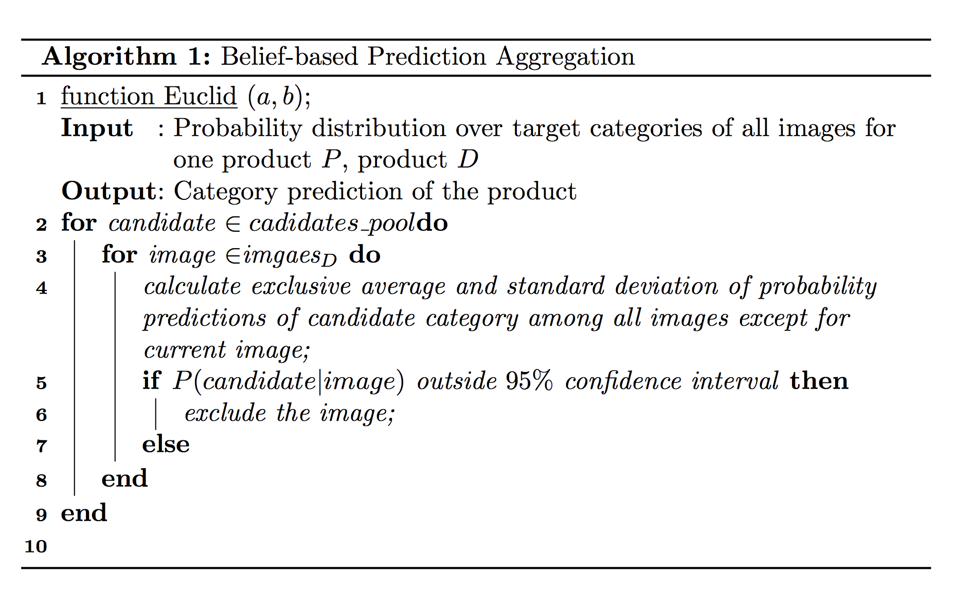
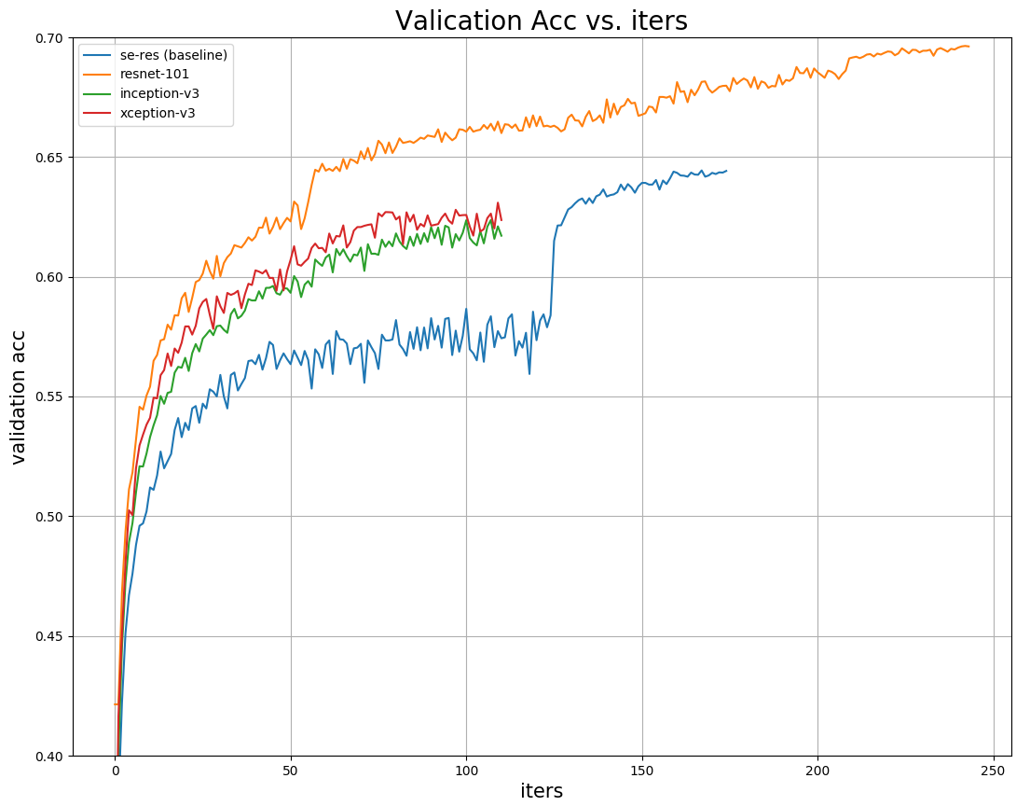
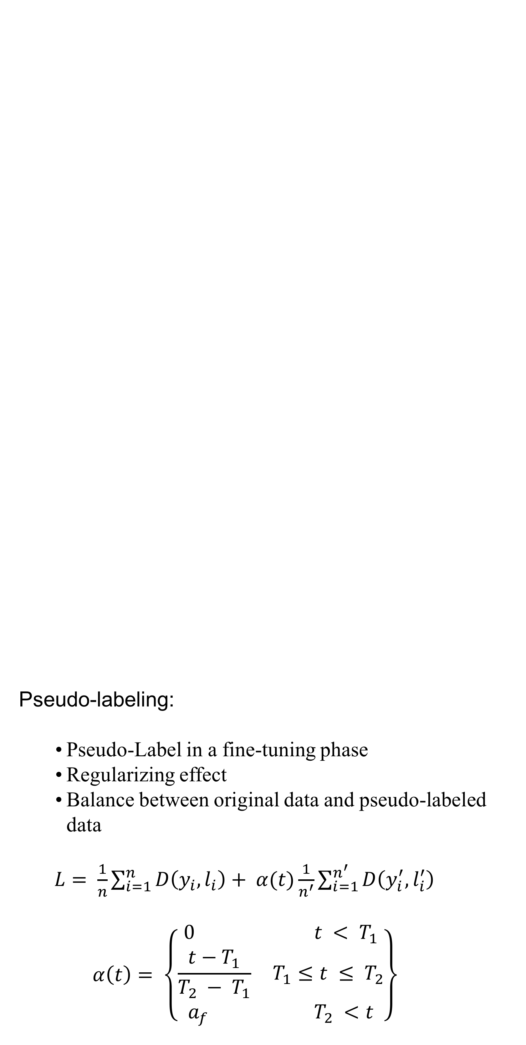
Deep Neural Network Ensemble for Extreme Classification
Yichen PAN, Yuxuan SUN
Carnegie Mellon University
Overview
Problem:
Extreme classification on Cdiscount’s dataset
Training: 12,118,359 images (6,924,452 products)
Testing: 3,095,080 images (1,768,182 products)
Categories: 5,270
Goal:
Classify each product (with 1-4 images) into 5,270 categories
Pseudo-labeling:
Pseudo-Label in a fine-tuning phase
Regularizing effect
Balance between original data and pseudo-labeled data
$L= \frac{1}{n}\sum_{i=1}^{n}{D\left(y_{i}, l_{i}\right)+ α(t)\frac{1}{n^{′}}\sum_{i=1}^{n^{′}}{D\left(y_{i}^{′}, l_{i}^{′}\right)}}$
$$α\left(t\right)= \left\{\begin{aligned}0 t < T_{1} \\ \frac{t−T_{1}}{T_{2} − T_{1}} T_{1}≤t ≤ T_{2} \\ a_{f} T_{2} <t\end{aligned}\right\}$$
Experiments/Results
Systematic simulation results for servo system:
Procedure terminates completely on 20th iteration
Set of ellipsoids computed represents set of reachable points for all time
Methodology:
Resnet:
Residual Learning
Identity Mapping by Shortcuts
Inception
Stack of Inception modules
Convolution factorization
Xception:
Depth-wise separable convolution layer
Residual connection
Test Time Augmentation (TTA):
Xxxx
Xxxxxx
xxxxxxx
A Gaussian confidence interval based prediction aggragation algorithm:
Comparison of computation times for the servo system example
Future Work
Procedure for refining estimate of reachable set
Techniques for accelerating reachset computations by seeding reachset with regions where the system is invariant (e.g., Lyapunov ellipsoids)
Procedure for synthesizing controllers based on reachability procedure

